Slide 1
HL7 FHIR Terminology Module
Joshua Wiedekopf
Institute of Medical Informatics
Universität zu Lübeck
Workshop SU-TermServ & NUM-RDP 2023-06-28

Slide 2
Resources in the HL7 FHIR Terminology Module

Slide 3
CodeSystem
“defines which codes exist, and how they are understood”
resource is made to define the existence of a CodeSystem with certain metadata
identity of the resource through canonical URIs and versions
concepts are assigned codes, and can be related through properties
FHIR makes little assumptions in the design of the content
mechanisms like postcoordination are explicitly allowed

Slide 4
Common Metadata
name
title
version
url
status
experimental
identifier (OIDs)
date
…

Slide 5
Example CodeSystem
ICD-10-GM is used for diagnosis coding throughout Germany
Maintenance by the BfArM
canonical URL SHOULD be defined within the authority of the BfArM
Codes are between three and ~6 characters in length and mostly look like “A01” or ”A01.1”
monohierarchical classification – A01.1 “is-a” A01
expressed through the “parent” property
some codes need additional context information (“cross-star coding”, codes with exclamation points ‘!’ or stars ’*’)
expressed through suitable properties

Slide 6
Resources in the HL7 FHIR Terminology Module

Slide 7
ValueSet
picks concepts from a (set of) CodeSystem(-s) and/or ValueSet(-s)
Used in a certain use case
identity though URL and version
used within other FHIR resources for “terminology binding”
different mechanisms of capturing the concepts required by the VS
extensional: pick codes as a list
intensional: use filters to select subsets at runtime
combination of extension and intension is possible
so is defining exclusions as well as inclusions
getting the set of concepts contained in an intensional VS is called “expansion”

Slide 8
Example of a ValueSet
In an oncological use-case, diagnoses should be captured via ICD-10-GM
The relevant codes are all of the “C” codes, with some also being in the ”D” chapter
Use an intensional filter for the ”C” codes (i.e. using RegEx);
Adding some concepts from SNOMED CT is also required to capture more specific diagnoses
add another include statement to the definition

Slide 9
Terminology Binding
Data elements in FHIR are not bound to CS directly, but against VS
Binding defines which concepts are allowed for a specific use case
E.g. Observation.code, Observation.status, Observation.category, Observation.valueCodeableConcept
binding defined through standard or in profiling
Binding strengths
required: can not be overriden, codes in instances SHALL be from this VS
extensible: Use provided codes where applicable, but other codes may be used
preferred: Do consider using this VS, but using different VS entirely is OK
example: this is merely an illustration of a set of concepts that could be used here

Slide 10
Coded Datatypes
 | code | Coding | CodeableConcept
Use Case | Context of binding is clear, and no other codes are allowed, codes are very simple strings | Not so much within core standard, more within extensions where the context of use is more controlled | Multiple codes meaning more-or-less the same thing in parallel, with additional display string
Example in standard | CodeSystem.status (draft, active, …) | CodeSystem.concept. property.valueCoding | Observation. valueCodeableConcept
Binding in profiles allowed | No | Yes | Yes
Multiple codings? | No | No | Yes
JSON datatype | String | Object with system, version, code, display, userSelected | Object with List<Coding> and display

Slide 11
Resources in the HL7 FHIR Terminology Module

Slide 12
ConceptMap
Mapping from one CodeSystem to another
always carried out in the scope of a certain usage
defined in terms of VSs
e.g. mapping from a classification (ICD-10-GM) to a terminology (SNOMED CT) looks very different for different use cases
relationship defines relatedness of the concepts

Slide 13
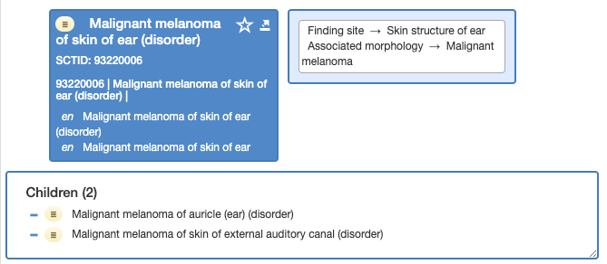
Example of a ConceptMap
For our ValueSet with the “cancer” codes we want to define mappings from ICD-10-GM to SNOMED CT
SNOMED CT is likely almost always more comprehensive than ICD-10-GM
machine can only map to high-level codes
if the CM is intended for supporting migrating to SNOMED CT with user intervention, defining multiple matching codes for each source concept to support the user selection is advisable
Mappings can’t really be inverted

Slide 14
Canonical URLs
“Preferred way to reference a resource instance for the resource types on which it is defined”
URI SHOULD resolve to the master copy of this resource, but that doesn’t always work
data type actually contains a URI instead of “just” an URL
terminological resources have multiple identities for each version
canonical URI
local URL (-s) of the server (-s)
[identifier (-s)]
{
"valueCodeableConcept": {
"coding": [
{
"system": "http://snomed.info/sct",
"code": "260385009",
"display": "Negative"
}, {
"system": "https://acme.lab/resultcodes",
"code": "NEG",
"display": "Negative"
}
],
"text": "Negative for Chlamydia Trachomatis rRNA"
}
}

Slide 15
Concepts
Codes only exist within a CodeSystem.
Codes give a name to concepts described by the CS.
Without specifying the CodeSystem, the code is not interpretable.
It might as well not be documented at all.

Slide 16
Operations
Framework for interacting with resources on a terminology server
exposed through HTTP operations
HTTP GET: Parameters provided via the URL as query parameters
HTTP POST: Parameters provided via a JSON/XML payload in the request (FHIR Parameters)
defined on resource type and on instances
CodeSystem/$lookup vs. CodeSystem/icd-10-gm-2023/$lookup
CodeSystem | ValueSet | ConceptMap
$lookup | $expand | $translate
$validate-code | $validate-code | $closure
$subsumes
$find-matches

Slide 17
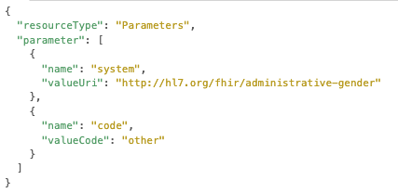
Operation Invocation (Example: CodeSystem/$lookup)
HTTP GET to:
https://terminology-highmed.medic.medfak.uni-koeln.de/fhir/CodeSystem/$lookup? system=http://hl7.org/fhir/administrative-gender&code=other
Benefit: super simple to use
HTTP POST to:
https://terminology-highmed.medic.medfak.uni-koeln.de/fhir/CodeSystem/$lookup
Benefit: more complex payload possible

Slide 18
Operation Parameters

Slide 19
Authentication using Insomnia

Slide 20
Listing resources & manipulating FHIR resources

Slide 21
CodeSystem Operations
$lookup
Concept Look Up & Decomposition: “Give me all you know about a concept identified via a code.”
$validate-code
Code System based Validation: “Does a CS contain a certain code?”
$subsumes
Subsumption Testing: “A is-a B?”
$find-matches
Finding codes based on supplied properties (Trial Use as of FHIR R5): ”Give me codes matching a set of properties”

Slide 22
CodeSystem/$lookup

Slide 23
CodeSystem/$validate-code

Slide 24
CodeSystem/$subsumes (Example: Hodgkin Lymphoma)

Slide 25
ValueSet Operations
$expand
Value Set Expansion:”What codes in which CodeSystems belong to a ValueSet?” (especially important for intensional VS)
also available: string filters → Search!
$validate-code
Value Set based Validation: ”Does a ValueSet contain a certain code in a given CodeSystem?”

Slide 26
ValueSet/$expand

Slide 27
ValueSet/$expand

Slide 28
ValueSet/$expand using contained resource in POST

Slide 29
Read More about FHIR Terminology Servers/Ontoserver
FHIR Terminology Module
Using Codes in Resources
Code Systems defined/referenced in FHIR
Value Sets Defined in FHIR
Resource and Operation specification
Ontoserver Website
Ontoserver technical documentation (also consider the Postman collection linked there)
mii-termserv.de (Work in Progress)

Slide 30
Takeaways
Interacting with the FHIR API is easy
The structure of the resources is easy
to read
to generate
The API is simple, but powerful
Sometimes, however, the client may need to do a bit of work on its end
Documentation is excellent

